Slide 1

What's new in ML?

Slide 2

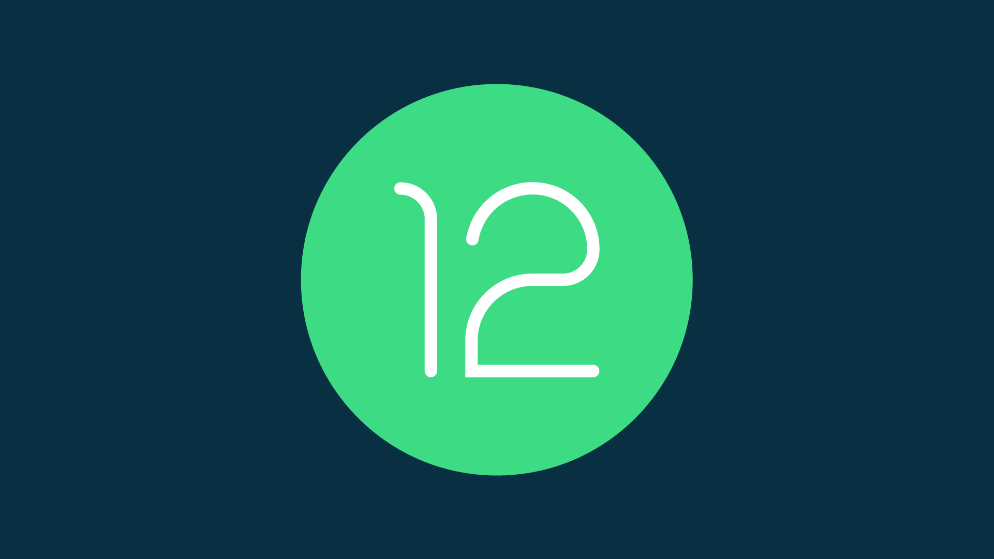
Android 12
Notes:
Native support for 5G.

Slide 3
User interface major updates

Slide 4
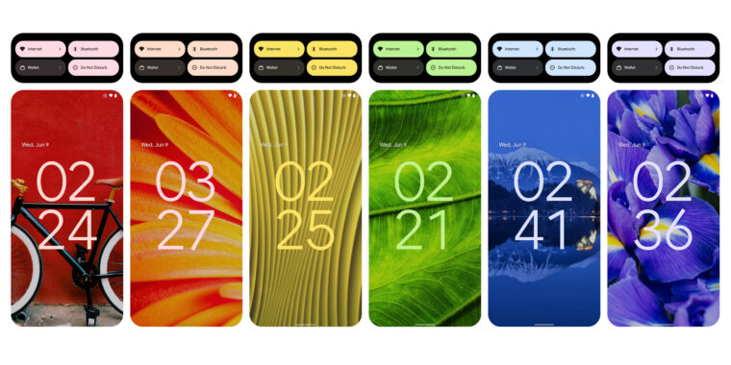
Color-changing user interface

Slide 5
Notification

Slide 6
New Ripple effect

Slide 7
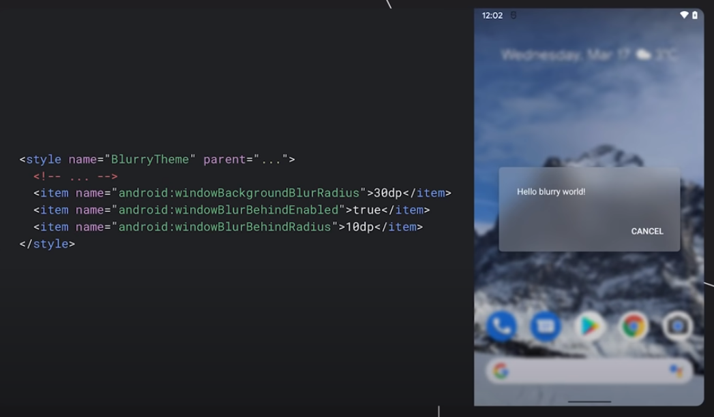
Blur effect
Notes:
Users will have more control over app access to location info, shared files and repositories like Photos and Videos.
Another helpful change: instead of apps automatically switching focus when they have an Activity in the background (like an alarm or call), .
Scoped Storage – which allows users to control how apps access external storage (say, in a MicroSD card). It will also better protect users from being identified by restricting access to non-resettable device identifiers, like your phone's serial number and/or IMEI, and randomizing its MAC address when connected to different Wi-Fi networks.

Slide 8
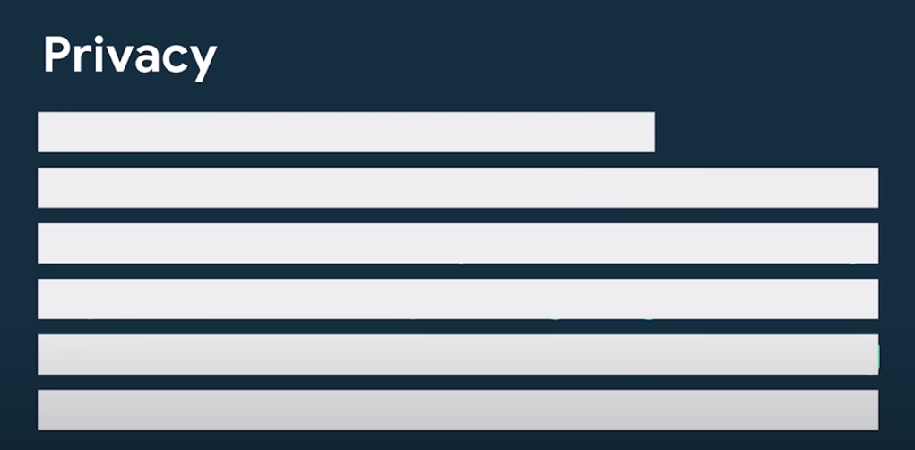
Notes:
Live Caption, which can automatically create captions for audio and videos. The feature can be used offline.
NLP without network
Project Euphonia

Slide 9
Privacy: Location

Slide 10
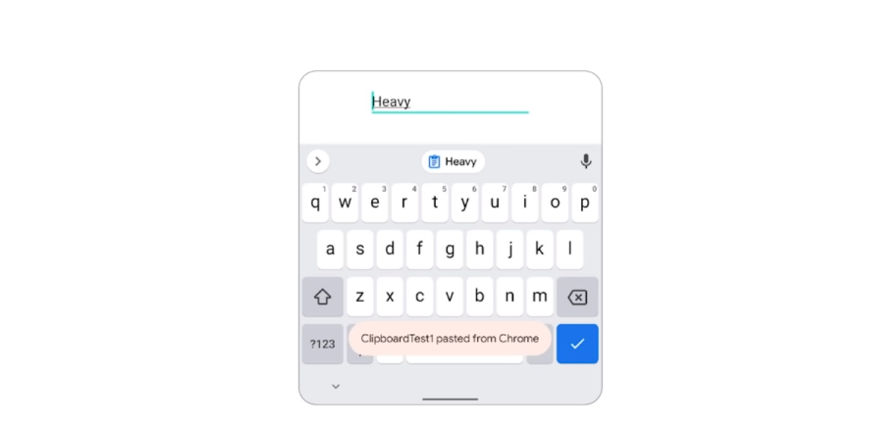
Privacy: Clipboard access

